Slide 1
Digital Circuit and System Lab07 Platform Architect
20240502
TA: 王俊傑 Chun-Chieh(Luka), Wang
Institute of Electronics,
National Yang Ming Chiao Tung University

Slide 2

Platform Architect
Platform Architect is a SystemC standards-based performance and power analysis tool for early SoC architecture exploration and design.
Helps optimize hardware-software partitioning
Can simulate cycle-accurate SystemC-based Models and HDL co-simulation with user-provided RTL

Slide 3
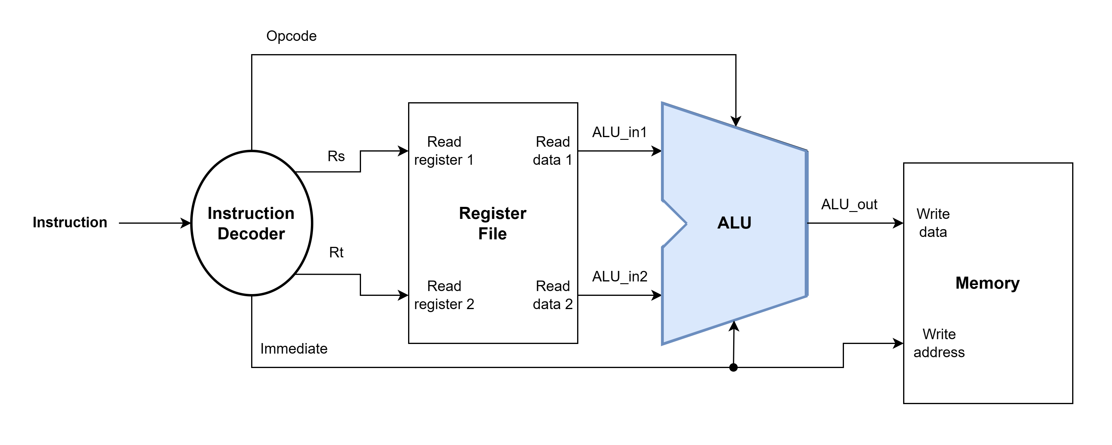
Design
Same as HW1
Verilog code : ALU
SystemC code : otherwise
To-Do
Don’t modify code
Complete PA simulation

Slide 4
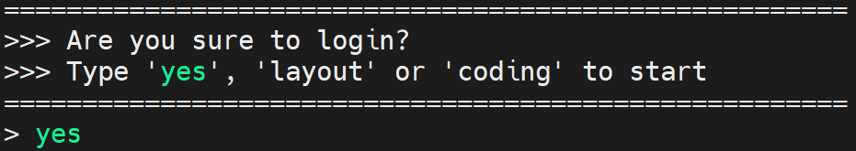
Environmental preparation
type ‘yes’ while you login the server
Source PA
source /RAID2/cad/synopsys/CIC/pa_virtualizer.cshrc
Extract files from TA’s directory (home directory)
tar -xvf ~DCSTA01/Lab07.tar

Slide 5
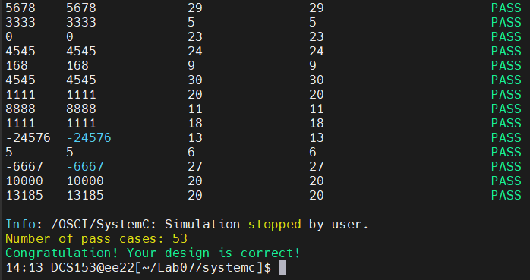
SystemC simulation
Simulation
cd ./Lab07/systemc
./01_systemc

Slide 6
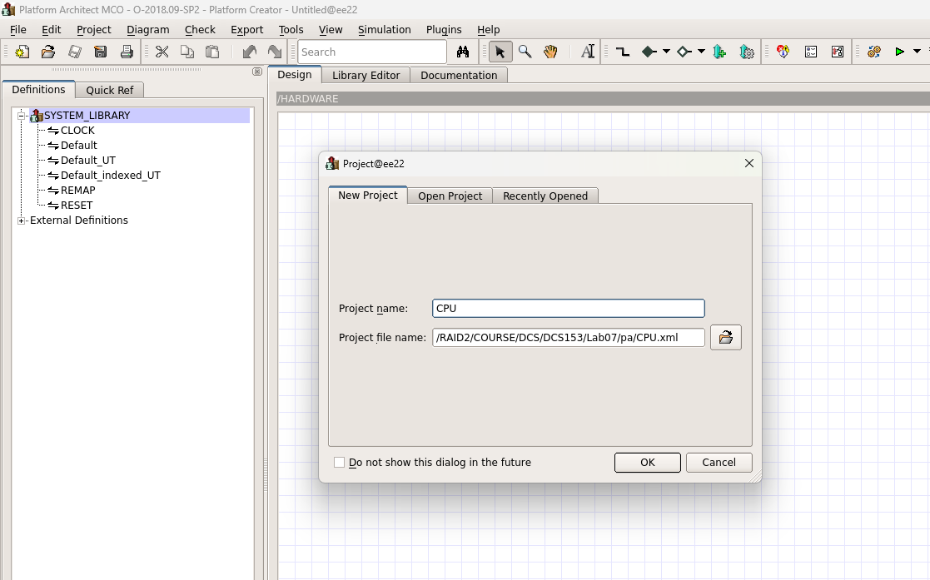
Platform Architect
PA
cd ./Lab07/pa
pct &

Slide 7
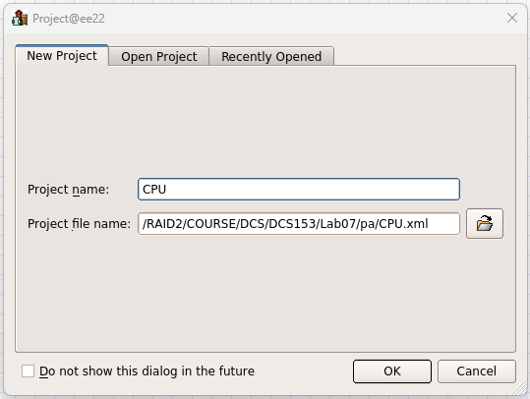
Platform Architect
File -> New project -> Project name -> OK

Slide 8
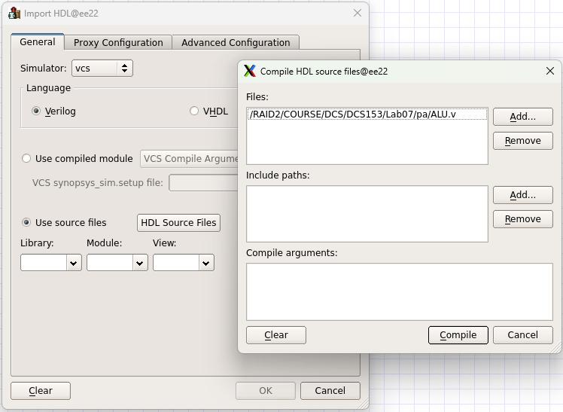
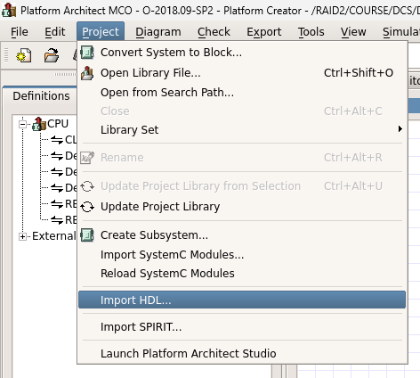
Platform Architect
Project -> Import HDL -> ●Use source files -> HDL Source Files -> Add -> Compile -> OK

Slide 9
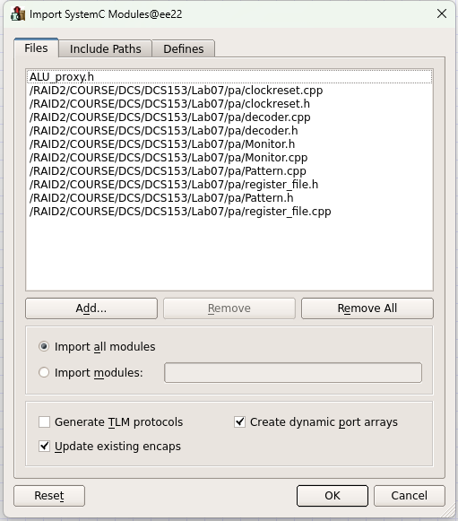
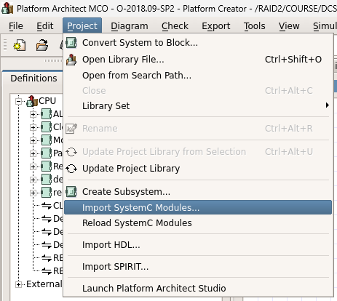
Platform Architect
Project -> Import SystemC Modules -> Add -> OK

Slide 10
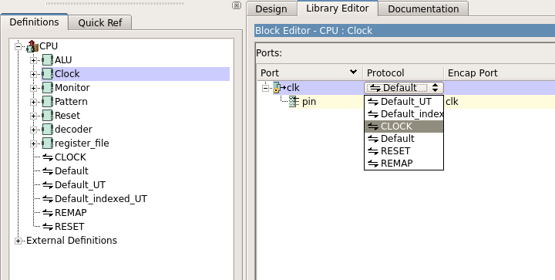
Platform Architect
Change protocol of clock port
Double click Clock -> Click Default -> Choose CLOCK

Slide 11
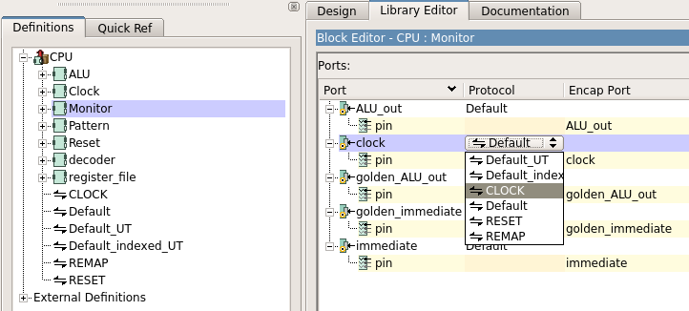
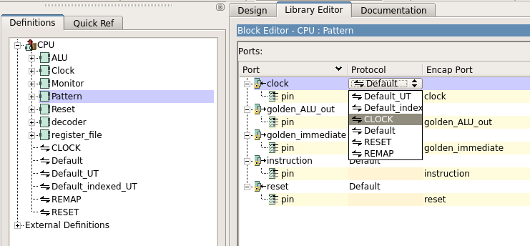
Platform Architect
Repeat the same action to change the clock protocol of Pattern and Monitor block

Slide 12
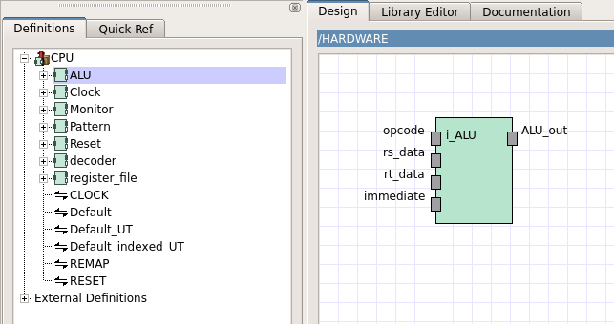
Platform Architect
Create the block
Click and drag to the design window

Slide 13
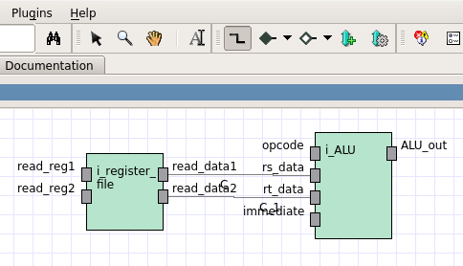
Platform Architect
Use connection tool to connect the block

Slide 14
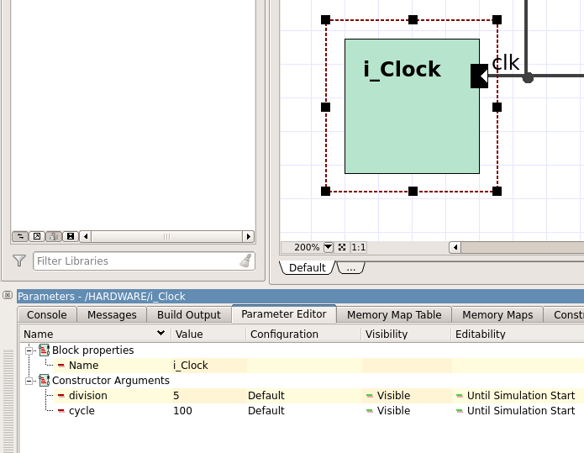
Platform Architect
Click Clock block -> Set clock period
division -> 5
cycle -> 100

Slide 15
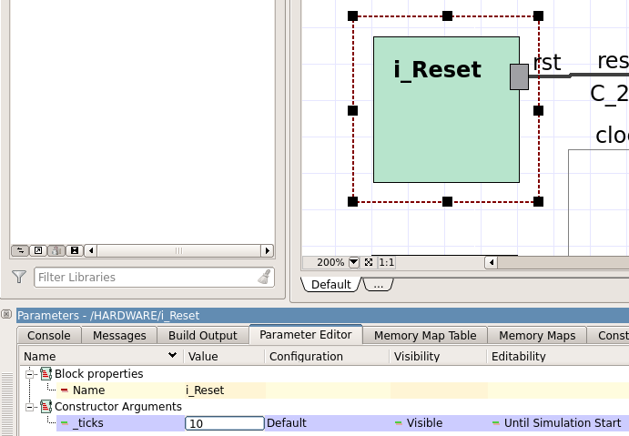
Platform Architect
Click Reset block -> Set reset period
_ticks -> 10

Slide 16
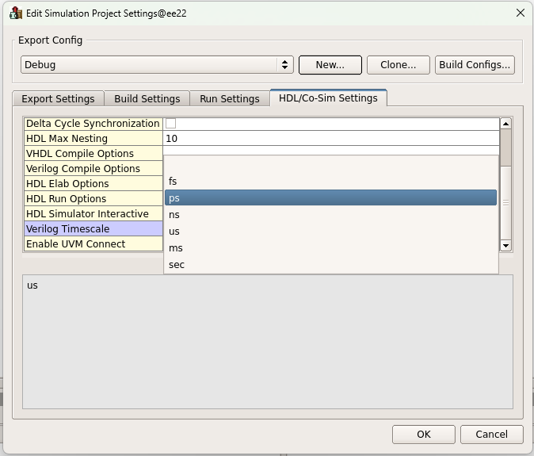
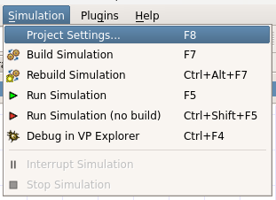
Platform Architect
Simulation -> Project Setting -> HDL/Co-Sim Setting -> Set Verilog Timescale -> ps -> OK

Slide 17
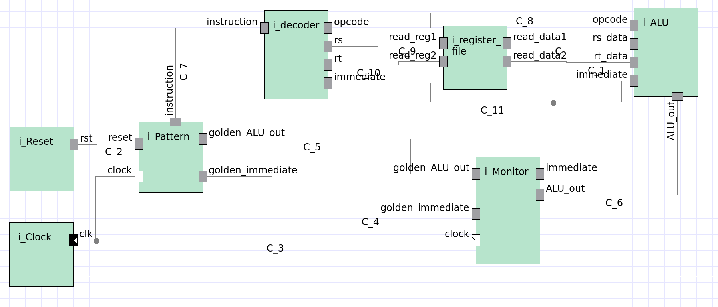
Platform Architect
Full Design

Slide 18
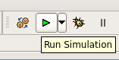
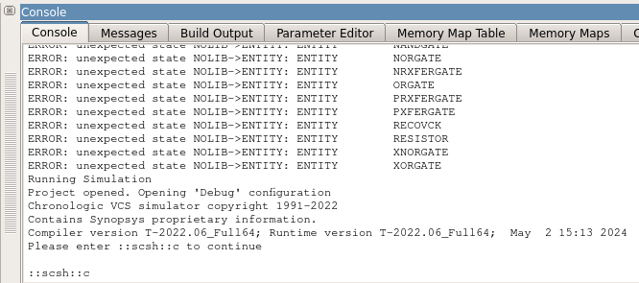
Platform Architect
Run Simulation -> Enter “::scsh::c” in command line

Slide 19
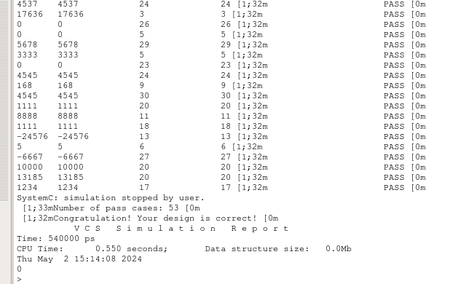
Platform Architect
Simulation Result

Slide 20
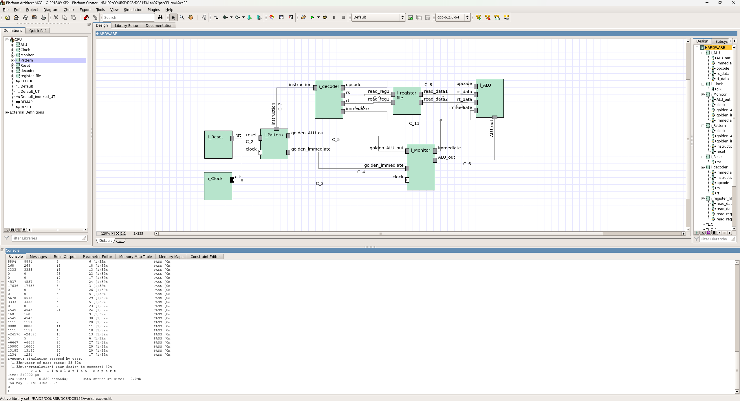
Lab Submission
Upload screenshots to E3@NYCU
must contain your server account, simulation results and module connection

Slide 21
Score
Finish this Lab:
Today: 100 points
On Friday: 100 points
On Saturday: 100 points
On Sunday: 100 points
On Monday: 60 points
After Monday: 0 points

